Slide 1



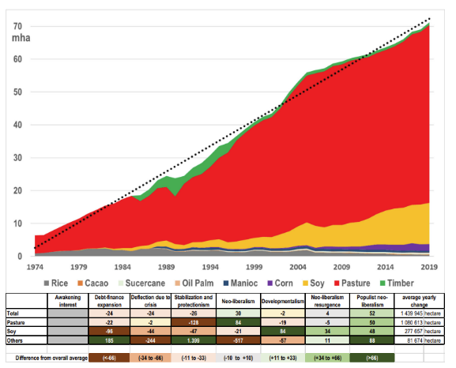
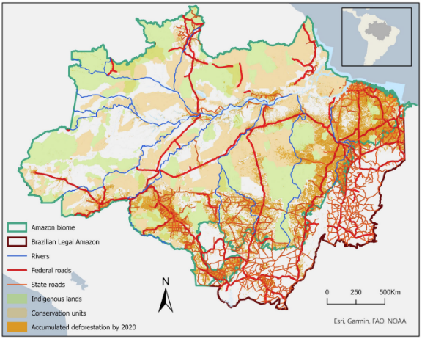
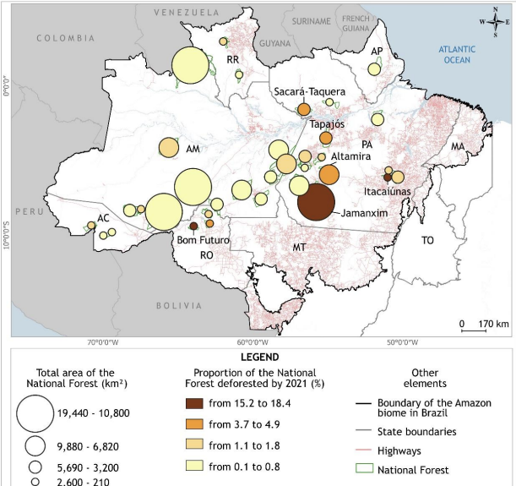
The Increase of Deforestation in the Amazon
Amelie Gardner
Faculty Sponsor: Professor Shelley Grant
Jacksonville University, Jacksonville, FL, USA
Introduction
Methods
Results
The original forest cover of the Brazilian Amazon biome- estimated at 4.1 million square km prior to 1970- has been progressively decreasing due to ongoing deforestation with approximately 84% (3.4 million square km) remaining at present (Garrett). Approximately 90% of global deforestation between 200 and 2019 was attributed to crop and pastureland expansion, positing commodity production as the primary direct driver of deforestation (Sylvester). Recently average net carbon loss in tropical regions have been estimated to about 59.8% in the Americas (Velasco). Deforestation in the Amazon rainforest is primarily due to poverty and insecure or unclear land ownership, exacerbated by food insecurity, migration, limited access to profitable land, and disputes over indigenous territories.
In the Amazon there are four main factors of deforestation: food insecurity, migration, limited access to profitable land, and disputes over indigenous lands. Food insecurity promotes deforestation because locals are not able to purchase food resulting in them turning towards the forest lands for use. Migration causes deforestation because of groups of people moving into new and unclaimed land to start a new life. With limited access to profitable lands, farmers and industries start cutting down the forest to use for their own profit. Indigenous territories are both protected and used by loggers because of poor government policies.
As a result of these issues, we see the Amazons biodiverse landscape being used by people to sustain themselves, and industries to make a profit off unprotected lands. Because of this the Amazon has become vulnerable to increasing deforestation. Food insecurity is forcing people to find a new way to live off the land, migration is caused by poverty and not having secure jobs, land use by the people is becoming uninhabitable, and indigenous people are facing threats of encroachment onto their lands because of insecure land rights. Major industries are causing the greatest distress for the people and the land in which they are using.
Visuals
Discussion
A potential solution to this problem may be to discuss land boundaries and territorial protection for indigenous territories. There also needs to be more access to profitable land for people who are living near and around the Amazon for them to have a chance to produce food for themselves.
Figure 1 depicts the uses of land by industries and how much land has been used by different forms of farming
Figure 2 visually shows us where the forests are currently located and what has taken up forested area
Figure 3 highlights where the Amazon has been deforested from 2023
Figure 1 - Pokorny Figure 2 - Pokorny Figure 3 - Gusmão
Conclusions
References
In conclusion, these main factors of deforestation are impacting the environment at an alarming rate. Deforestation is mainly due to human factors where big industries are the main causes of loss of land for the biodiverse environment that animals and plants need to survive in the Amazon. Researchers need to address these issue all around the world to sustain our planet for the future of our society.
Ferrer Velasco, R., et al. "Scale and Context Dependency of Deforestation Drivers: Insights from Spatial Econometrics in the Tropics." PLoS ONE, vol. 15, no. 1, 2020, pp. 1-32. DOI, 10.1371/journal.pone.0226830. EBSCOhost, research.ebsco.com/linkprocessor/plink?id=6b2d5538-bcf8-32e5-8521-08f620b2611c. Accessed 11 Feb. 2025.
Garrett, R. D., et al. "Forests and Sustainable Development in the Brazilian Amazon: History, Trends, and Future Prospects." Annual Review of Environment & Resources, vol. 46, 2021, pp. 625-652. DOI, 10.1146/annurev-environ-012220-010228. EBSCOhost, research.ebsco.com/linkprocessor/plink?id=55ab99a6-5d68-3596-89f5-1e79d7731779. Accessed 11 Feb. 2025.
Gusmão, L. H. A., et al. "National Forests in the Brazilian Amazon: Deforestation and Land Use Pressures (2018-2021)." Ra’e Ga, vol. 60, 2024, p. 19. DOI, 10.5380/raega.v60i0.96579. EBSCOhost, research.ebsco.com/linkprocessor/plink?id=a0e1138d-c9a7-3d86-949a-059c6111decd. Accessed 11 Feb. 2025.
Pokorny, B., et al. "Forest Frontiers Out of Control: The Long-Term Effects of Discourses, Policies, and Markets on Conservation and Development of the Brazilian Amazon." AMBIO: A Journal of the Human Environment, vol. 50, no. 12, 2021, pp. 2199-2223. DOI, 10.1007/s13280-021-01637-4. EBSCOhost, research.ebsco.com/linkprocessor/plink?id=6e6b4775-d29e-3d2d-b746-8ed6de8f33a0. Accessed 11 Feb. 2025.
Sylvester, J. M., Gutiérrez-Zapata, D. M., Pérez-Marulanda, L., Vanegas-Cubillos, M., Bruun, T. B., Mertz, O., & Castro-Nunez, A. (2024). Analysis of food system drivers of deforestation highlights foreign direct investments and urbanization as threats to tropical forests. Scientific Reports, 14(1), 1–12. https://doi.org/10.1038/s41598-024-65397-3.

